Slide 1
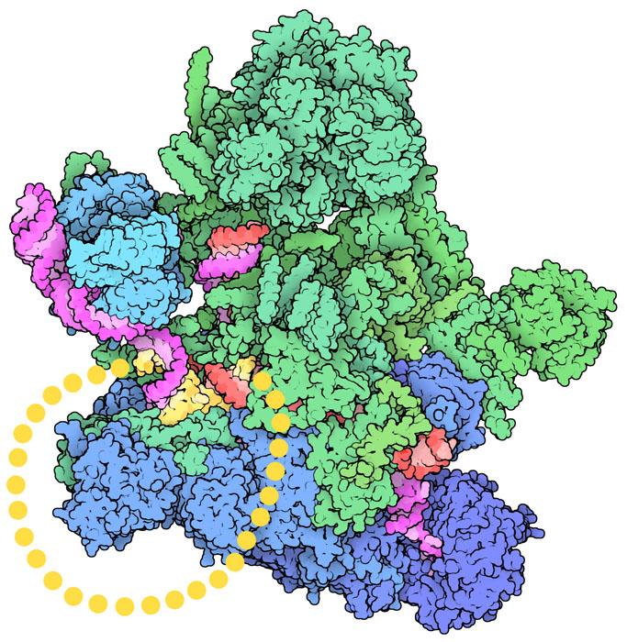
Tema 10.
RNA capping, RNA poli-ADENILACIÓN y RNA splicing
Módulo II. Flujo de información
Tema 10. Procesamiento de RNA
PDB-101: Educational resources supporting molecular explorations through biology and medicine. Christine Zardecki, Shuchismita Dutta, David S. Goodsell, Robert Lowe, Maria Voigt, Stephen K. Burley. (2022) Protein Science 31: 129-140 https://doi.org/10.1002/pro.4200.
Materials and images are free for use under a CC By 4.0 license.
https://pdb101.rcsb.org/motm/245

Slide 2
Ribozimas: biomoléculas de ácido nucleico con actividad catalítica
Las ribozimas rompen o forman enlaces fosfodiéster. El sustrato es RNA
La capacidad del RNA de formar estructuras tridimensionales estables permite la interacción proteína ligando.
Los dos ejemplos más característicos de ribozimas son los snRNAs del spliceosome y el componente RNA de los ribosomas que cataliza la formación del enlace peptídico. También merecen mención de los intrones self-splicing o la Rnasa P (hipótesis del mundo RNA).
La RNasa P es una de las dos ribozimas presentes en casi todos los organismos, siendo la otra el ribosoma. Sorprendentemente, el RNA es muy similar en la RNasa P nuclear de bacterias, arqueas y eucariotas.
PDB-101: Educational resources supporting molecular explorations through biology and medicine. Christine Zardecki, Shuchismita Dutta, David S. Goodsell, Robert Lowe, Maria Voigt, Stephen K. Burley. (2022) Protein Science 31: 129-140 https://doi.org/10.1002/pro.4200. Materials and images are free for use under a CC By 4.0 license.
Notes:
The activities of many ribozymes, natural and selected in the laboratory, consist of breaking or joining phosphodiester bonds in RNA substrates. In some cases, such as self-splicing introns, the breaking and joining are coupled, whereas other ribozymes, such as RNase P, catalyze bond cleavage only.
RNA molecules use weak interactions, including the hydrophobic interactions and hydrogen bonding inherent in base pairing and base stacking, along with site-specific metal ion coordination, to form a wide variety of structures with ligand-binding sites and catalytic centers. DNA molecules are inherently less able to form such stable three-dimensional structures, due to subtle but crucial differences in the geometry of the phosphodiester backbone and the lack of a 2′ hydroxyl in DNA nucleotides. RNA is therefore uniquely positioned in biology not only to encode genetic information but also to modify it, and possibly even to replicate it.
In the eukaryotic spliceosome, the splicing reaction requires a catalytic center formed, at least in part, by the U2, U5, and U6 snRNAs. And perhaps most importantly, an RNA component of ribosomes catalyzes the synthesis of proteins.
The RNA world hypothesis proposes that organisms comprised entirely or mostly of RNA evolved on early Earth. The base-pairing properties of RNA could have been used to store information, as occurs today in many viruses, and the capacity of RNA to form a variety of structures lent itself to the emergence of ribozymes and perhaps other functional molecules, such as those forming membrane-spanning pores.
Eventually, DNA supplanted RNA as a data storage molecule because of its greater chemical stability. Proteins, with broader catalytic capabilities stemming from chemically diverse amino acids, became the specialized catalytic molecules. The few remaining ribozymes are remnants of the RNA world and provide clues to its former existence.

Slide 3
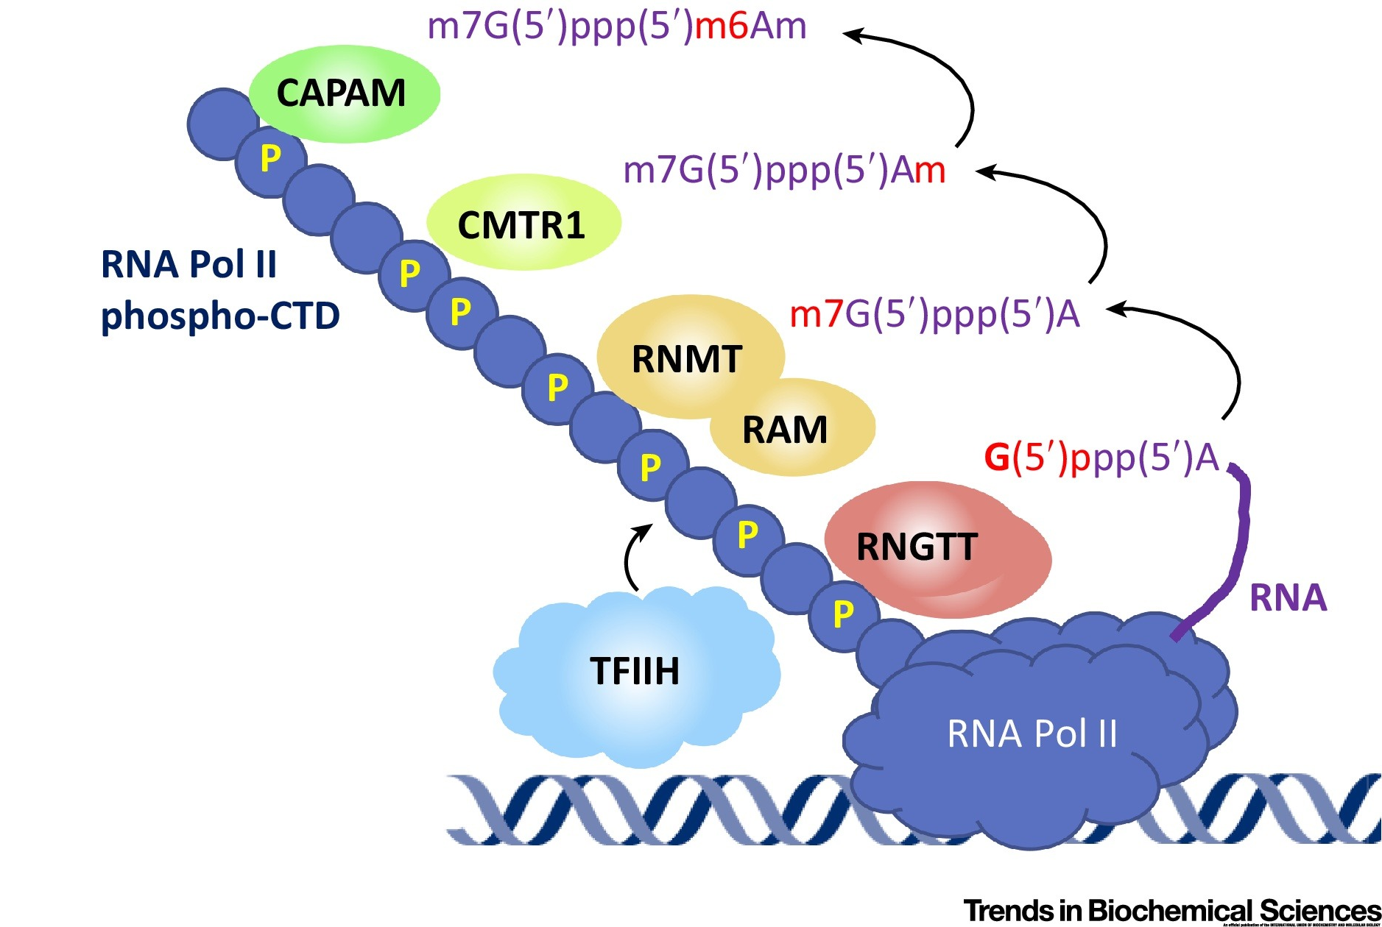




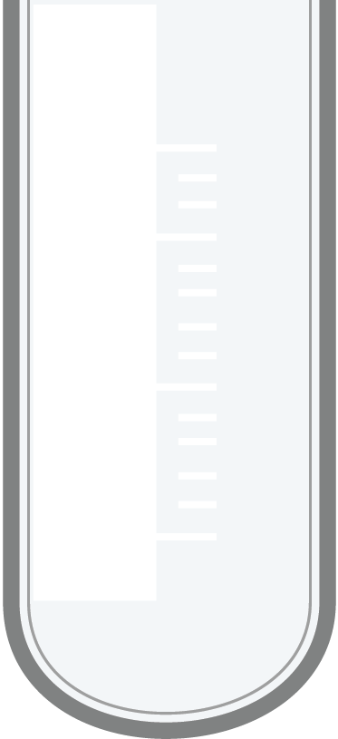
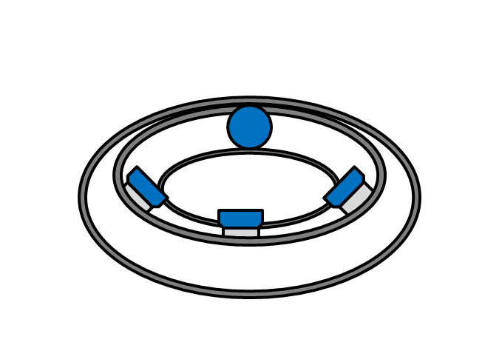
La adición de una cola 5´ Cap (m⁷G Cap) a los RNA sintetizados por Pol II protege y ayuda a la interacción ribosoma mRNA
mRNA Capping Enzymes Recruited to RNA Polymerase II (Pol II) During Transcription
Ribosome binding to reovirus mRNA in protein synthesis requires 5 terminal 7-methylguanosine. Cell 6:185–195 (1975)
³²P reovirus mRNA
³²P reovirus mRNA
H³-m⁷G Cap
5% sucrose
5% sucrose
20% sucrose
20% sucrose
Copyright: © 2019 The Author. Published by Elsevier Ltd.
User License: Creative Commons Attribution (CC BY 4.0)
Notes:
mRNA Capping Enzymes Recruited to RNA Polymerase II (Pol II) During Transcription. During the initial phase of transcription, TFIIH phosphorylates the Pol II C-terminal domain (CTD) on serine 5. The capping enzymes are then recruited to the phosphorylated RNA Pol II. Next to each capping enzyme is a cap structure that they produce, with the specific component added marked in red. RNA is synthesised with a 5′ triphosphate. RNGTT is a triphosphatase and guanylyltransferase that adds the inverted guanosine cap to nascent RNA. The other enzymes, RNMT-RAM, CMTR1 and CAPAM, are methyltransferases. RNA is depicted as a purple strand.
5′ cap:A residue of 7-methylguanosine (7-meG) linked to the 5′-terminal residue of an mRNA through a 5′,5′-triphosphate linkage, which protects the mRNA from exoribonucleases.
In the 1970s, experiments by Aaron Shatkin and his colleagues showed that the 5′ cap also plays a critical role in binding the mRNA to a ribosome. Using mRNAs isolated from reovirus, a human virus that can cause stomach flu, Shatkin’s research group found that only mRNAs containing a 5′ cap are competent to initiate protein synthesis. Viral mRNAs lacking a 5′-methylated terminus are never part of actively translating ribosomes, because they fail to bind to the 40S ribosomal subunits during the translation initiation process. Shatkin and colleagues used the reovirus RNA polymerase to synthesize reoviral mRNAs, using [32P]GTP and [3H]methyl-S-adenosylmethionine. Some of the resulting transcripts contained a 5′-7-meG cap (and thus were 3H- and 32P-labeled) and the rest lacked a cap (32P-labeled only). These mRNAs were incubated with wheat germ cell extract to allow the mRNAs to bind to ribosomes. The samples were then deposited at the top of a sucrose density gradient and spun in a centrifuge, so that the samples migrated into the gradient according to their density. When the resulting gradients were fractionated, and each fraction measured for its content of 3H- and 32P-containing material, the capped mRNAs were found in the dense part of the gradient where ribosomes were located, indicating that the capped mRNAs were bound to the ribosomes. In contrast, the uncapped mRNAs (containing only 32P) migrated only to the top of the gradient.

Slide 4
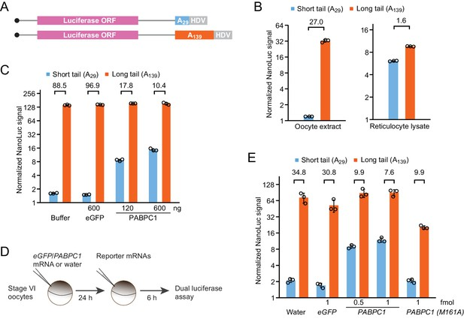
La adición de una cola 3´poliA a los RNA sintetizados por Pol II protege de la degradación enzimática e influye en la eficiencia de la traducción
El mRNA contiene una señal de poliadenilación en el transcrito primario. La polimerasa escinde el transcrito justo después de esta señal.
Proteínas que interaccionan con el dominio C-terminal de la polimerasa (PABP) añaden la cola poli(A), entre 80 y 250 residuos adenina.
https://elifesciences.org/articles/66493
© 2021, Xiang and Bartel
This article is distributed under the terms of the Creative Commons Attribution License, which permits unrestricted use and redistribution provided that the original author and source are credited.
Notes:
The 3′ poly(A) tail, typically mRNAs contain a polyadenylation signal embedded in the sequence transcribed by RNA polymerase. An enzyme associated with the C-terminal domain of Pol II cleaves the transcript after the polyadenylation signal, and the mRNA is polyadenylated by other CTD-associated factors. The rest of the transcript dissociates from the polymerase and is degraded.
The 3′ poly(A) tail, typically 80 to 250 A residues, serves as a binding site for one or more specific proteins that help protect mRNA from enzymatic destruction, by physically blocking the access of ribonucleases to the 3′ end
PABPC overexpression uncouples poly(A)-tail length and TE in frog oocytes.
(A) Schematic of capped T7 transcripts with two different tail lengths, which were used as reporter mRNAs. Additional sequences beyond the HDV sequence are not depicted. (B) The effect of tail length on relative yields of in vitro translation of short- and long-tailed Nluc reporter mRNAs, in either frog oocyte extract (left) or rabbit reticulocyte lysate (right). The number above each bracket indicates the fold difference of the mean normalized luciferase signal (error bars, standard deviation from three technical replicates). (C) The effect of purified PABPC1 on relative yields of in vitro translation of short- and long-tailed Nluc reporter mRNAs in frog oocyte extract. Purified eGFP and PABPC1 were each added as indicated. Otherwise, this panel is as in (B). (D) Experimental scheme for serial-injection of mRNAs into frog oocytes. (E) The effect of overexpressing PAPBC1 and a PABPC1 M161A mutant on relative translation of Nluc reporter mRNAs in frog oocytes. Differential PABPC1 expression was achieved by injecting the indicated amount of mRNA in the first injection (error bars, standard deviation from three biological replicates). Otherwise, this panel is as in (B).

Slide 5
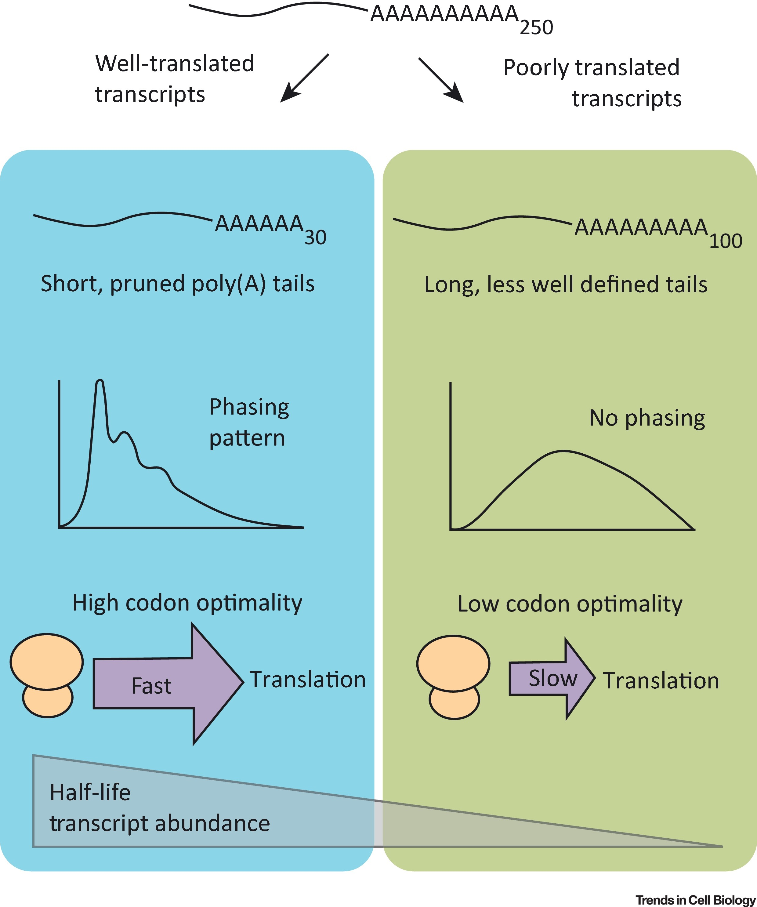
Las colas de poli(A) son secuencias dinámicas.
En células somáticas, los mRNA de alta expresión se acumulan con colas de poli(A) relativamente cortas.
Las proteínas de unión a poli(A) tienen dos funciones: facilitan la actividad de las deadenilasas y protegen la cola de poli(A).
Traducción realizada con la versión gratuita del traductor DeepL.com
This article is distributed under the terms of the Creative Commons Attribution License, which permits unrestricted use and redistribution provided that the original author and source are credited.

Slide 6
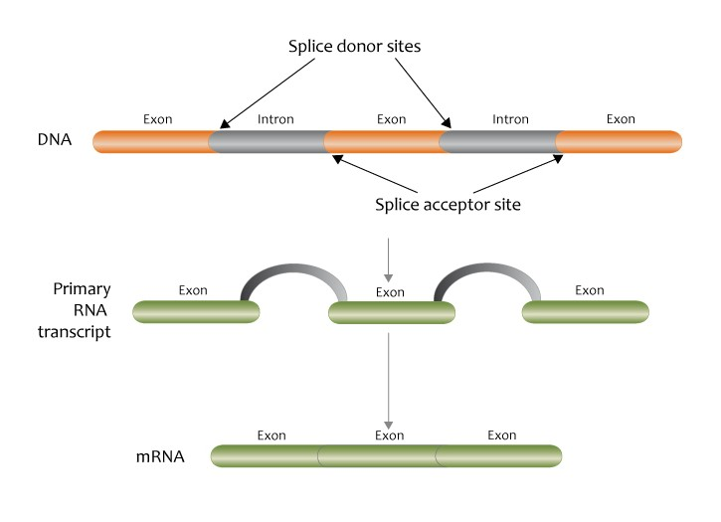
El splicing preciso y eficaz depende de las interacciones entre el pre-mRNA y el spliceosome
El splicing del pre-mRNA consiste en la ruptura y ligación ordenada de enlaces fosfodiéster específicos para lograr la escisión precisa de intrones.
Un complejo de RNA y proteínas denominado spliceosome es responsable del pre-mRNA splicing. En comparación con los ribosomas, los spliceosomes son más dinámicos.
Un pequeño número de intrones que se encuentran en los transcritos mitocondriales, de cloroplastos y de bacteriófagos catalizan su propia escisión.
Genomics Education Programme, CC BY 2.0, via Wikimedia Commons
Notes:
All pre-mRNA splicing mechanisms consist of the ordered breaking and joining of specific phosphodiester bonds to achieve the precise excision of introns.
A complex of RNA and proteins called the spliceosome is responsible for most pre-mRNA splicing. Compared with ribosomes, spliceosomes are much more dynamic multipiece machines; their assembly occurs at pre-mRNA splice sites and determines whether a given set of splice sites will be used. A small number of introns found in mitochondrial, chloroplast, and bacteriophage transcripts are self-splicing, catalyzing their own excision from a primary transcript without help from proteins.

Slide 7
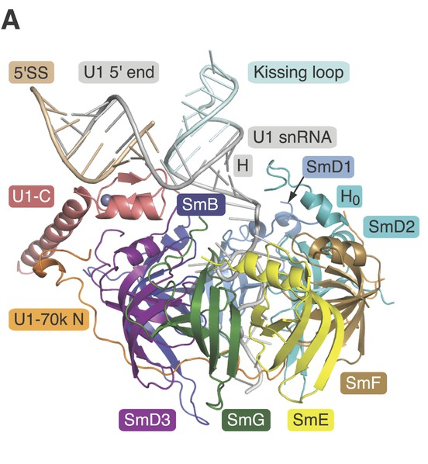
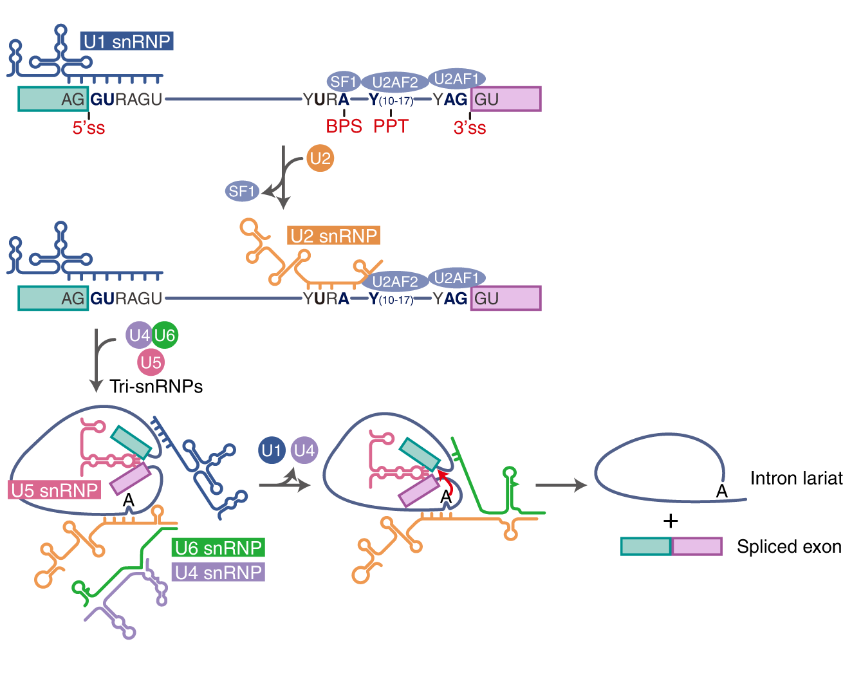
El splicing preciso y eficaz depende de las interacciones entre el pre-mRNA y snRNAs del el spliceosome
Schematic representation of the stepwise assembly of the spliceosome from its small nuclear ribonucleoprotein (snRNP) components.
Choi, S., Cho, N. & Kim, K.K. The implications of alternative pre-mRNA splicing in cell signal transduction. Exp Mol Med 55, 755–766 (2023). https://doi.org/10.1038/s12276-023-00981-7
Open Access This article is licensed under a Creative Commons Attribution 4.0 International License
https://doi.org/10.7554/eLife.04986
© 2015, Kondo et al.
Creative Commons Attribution License
Notes:
Schematic representation of the stepwise assembly of the spliceosome from its small nuclear ribonucleoprotein (snRNP) components. Binding of U1 to the 5′ splice site and U2 to the branch point results in the formation of the A complex. The tri-snRNP U4/U6.U5 joins the A complex to form the B complex. Removal of U1 and U4 lead to the activation of the spliceosome. After completion of the first splicing step, the C complex is formed. After the second splicing step, the spliced mRNA product is released from the post-splicing (P) complex
a The spliceosome machinery recognizes and binds the 5’ splice site (5’ss; GU), 3’ splice site (3’ss; AG), branch point site (BPS), and polypyrimidine tract (PPT). U1 snRNP generates base pairs with the 5’ss, and U2 snRNP base pairs with the BPS. Then, tri-snRNPs consisting of U4, U5, and U6 are recruited, and U1 and U4 snRNPs are released. This step induces conformational changes in the pre-mRNA and catalyzes two successive transesterification reactions to generate ligated exon and intron lariats.
Most introns in eukaryotic pre-mRNAs are removed by the spliceosome, a complex of five small nuclear ribonucleoproteins, or snRNPs (pronounced “snurps”), and hundreds of additional protein components. At the heart of each snRNP is a single small nuclear RNA (snRNA) belonging to a class of non-protein-coding eukaryotic RNAs 100 to 200 nucleotides long. Five snRNAs (U1, U2, U4, U5, and U6) involved in splicing reactions are abundant in eukaryotic nuclei. The RNAs and proteins found in snRNPs are highly conserved in eukaryotes from yeast to humans, suggesting that the splicing machinery, and hence introns themselves, were present in the earliest eukaryotes.
Each snRNA includes a binding site for a set of proteins—Sm proteins—that are common to all snRNPs. Seven Sm proteins (SmB, D1, D2, D3, E, F, and G) form a ringlike structure that binds adjacent to a hairpin fold near the 3′ end of the snRNA. In addition, the snRNA contains sequences that are uniquely recognized by proteins specific to that snRNP. The snRNA–Sm protein complex forms a structure called the Sm core domain.
GU and AG at their 5′ and 3′ ends, respectively, and these sequences mark the sites where splicing occurs. However, these dinucleotide sequences at splice junctions are, by themselves, not sufficiently information-rich to specify splice sites accurately. The surrounding sequences and perhaps the structure of the pre-mRNA itself must play a role in the selection of splice sites, and the ability of snRNPs to bind to these sequences affects the likelihood of splicing.
Some pre-mRNA introns are spliced by a less common type of spliceosome, in which the U1 and U2 snRNPs are replaced by the U11 and U12 snRNPs. Whereas U1- and U2-containing spliceosomes remove introns with 5′-GU and AG-3′ terminal sequences, the U11- and U12-containing spliceosomes remove a rare class of introns that have 5′-AU and AC-3′ terminal sequences at the intron splice sites.

Slide 8
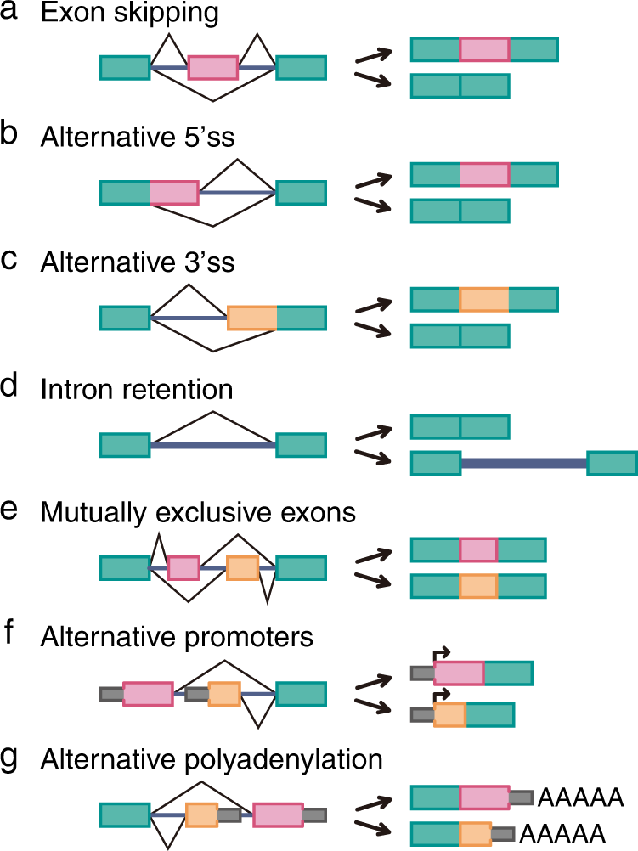
El splicing alternativo genera múltiples productos a partir de un gen
El splicing alternativo es un proceso en el que los exones del transcrito primario de un gen se procesan de manera diferente para producir mRNA diferentes y, por tanto, polipéptidos distintos.
Es destino molecular de las isoformas puede ser:
STOP prematuro: Nonsense-mediated decay
Transcrito funcional: diferente localización y estabilidad de mRNA
Proteína funcional: diferente eficiencia de traducción, estructura o interactores
La regulación por splicing alternativo está implicada en algunas enfermedades humanas (CD44)
Choi, S., Cho, N. & Kim, K.K. The implications of alternative pre-mRNA splicing in cell signal transduction. Exp Mol Med 55, 755–766 (2023). https://doi.org/10.1038/s12276-023-00981-7
Open Access This article is licensed under a Creative Commons Attribution 4.0 International License
Notes:
(A) Alternative splicing can be achieved through multiple distinct mechanisms that include exon skipping, alternative 3′ and 5′ splice sites, intron retention, or a combination thereof.
(B) Alternatively spliced transcripts can have two general molecular fates; transcripts containing premature stop codons are degraded through nonsense-mediated decay; in-frame alternative splicing alters the function of the transcripts at the post-transcriptional (mRNA localization and stability) and/or post-translational (protein sequence and modifications) level.
Regulation by alternative splicing is implicated in some human disease pathways. For example, the inclusion of specific exons in the spliced mRNAs encoding the cell surface molecule CD44 is associated with the progression of certain tumors from localized malignancies to invasive growths. Thus, understanding what determines exon choice during alternative splicing might lead to new therapeutic strategies to treat or prevent some cancers.

Slide 9
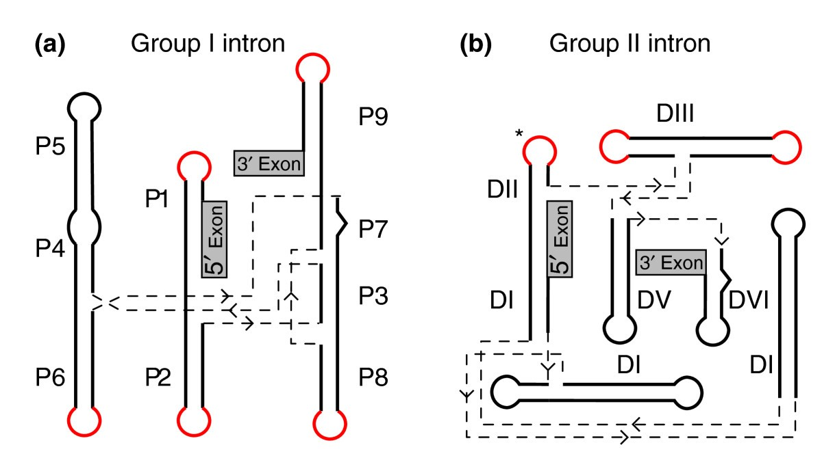
Algunos intrones no requieren enzimas para escindirse
La existencia de moléculas de RNA catalítico implica que el RNA podría haber constituido la base química de la vida primitiva en la Tierra, antes de la evolución del DNA o las proteínas.
Existen dos clases de intrones que se autoprocesan: Clase I y Clase II
Los intrones del grupo I y del grupo II requieren proteínas para el procesamiento in vivo, no para la catálisis, sino para forzar el pre-RNA en la conformación correcta para que se produzca el procesamiento.
BMC Biology April 2011 9(1):22
DOI:10.1186/1741-7007-9-22
Source PubMed
License CC BY 2.0
Notes:
(a) A DNA fragment including the intron (red) and flanking sequences (blue) was cloned into a plasmid, which was then transcribed in a test tube by purified RNA polymerase. (b) Samples of pre-rRNA purified from this transcription reaction were incubated in buffer solutions containing sodium and magnesium salts. The pre-rRNA was capable of self-splicing to release the intron, as shown in this agarose gel. The (shorter) intron RNA moves through the gel matrix faster than the (longer) starting transcript. Increasing salt concentration (shown at the top) facilitates the splicing reaction because salts stabilize the folded, catalytically active form of the RNA.

Slide 10
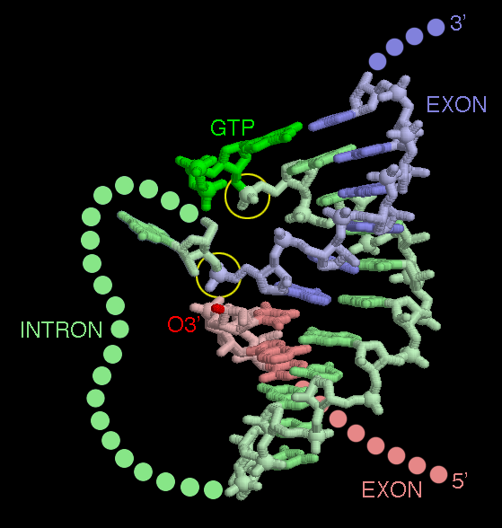
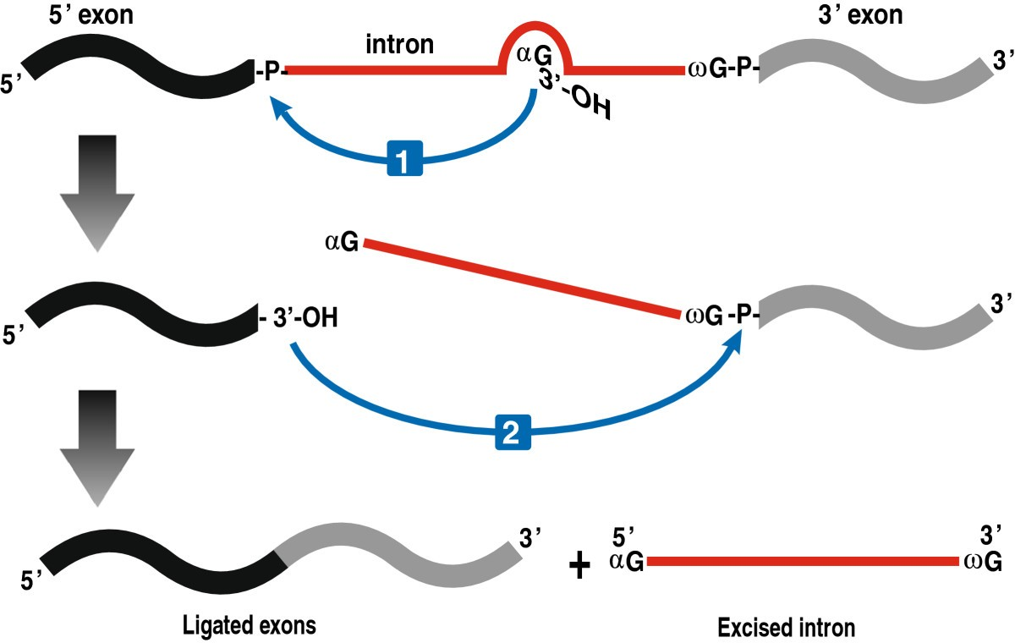
Algunos intrones no requieren enzimas para escindirse
PDB-101: Educational resources supporting molecular explorations through biology and medicine. Christine Zardecki, Shuchismita Dutta, David S. Goodsell, Robert Lowe, Maria Voigt, Stephen K. Burley. (2022) Protein Science 31: 129-140 https://doi.org/10.1002/pro.4200.
Materials and images are free for use under a CC By 4.0 license.
Hausner, G., Hafez, M. & Edgell, D.R. Bacterial group I introns: mobile RNA catalysts. Mobile DNA 5, 8 (2014). https://doi.org/10.1186/1759-8753-5-8
This is an Open Access article is distributed under the terms of the Creative Commons Attribution License ( https://creativecommons.org/licenses/by/2.0 )
Notes:
The self-splicing RNA in PDB entry 1u6b has been caught in the middle of its splicing reaction.
Schematic representation of group I intron splicing. The splicing pathway consists of two sequential transesterification reactions. The first reaction is initiated by the 3′–OH group of an exogenous GTP (αG) that docks into the G-binding pocket located in the P7 region and the 3′–OH group attacks the 5′ splice site. In the second reaction, the 3′–OH of the released 5′ exon attacks the phosphodiester bond between the intronic terminal G (ωG) and the 3′ exon, resulting in the liberation of the intron and the ligation of the exons.

Slide 11

Presentación diseñada y elaborada por Julia Quintana González

Slide 12

Anotaciones

Slide 13

Preguntas

